Slide 1

“
Overview & Comparative study of
Object Detection Algorithms
NTCC Project
”

Slide 2
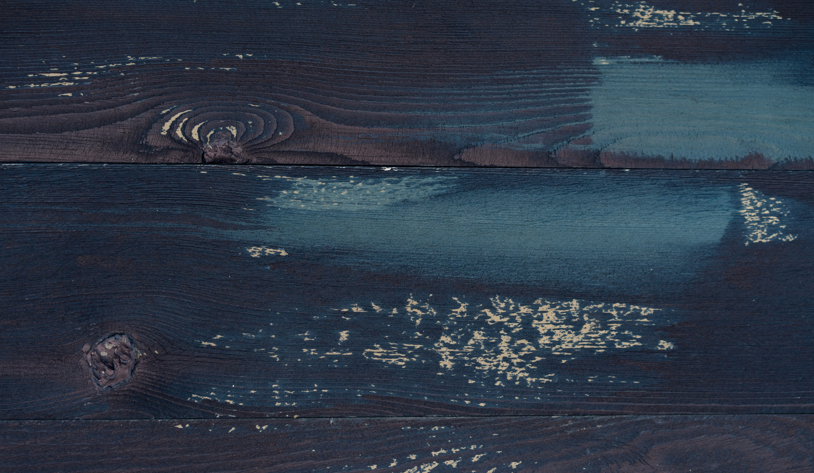
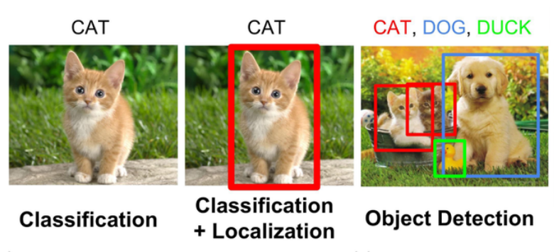
Introduction to R-CNN family
R-CNN family of Object Detection Algorithms include
R-CNN, Fast R-CNN, Faster R-CNN
CONTENTS
Comparative Study of R-CNN Algorithms:-
Here we will have a look at various metrics used for comapiring among R-CNN family of Algorithms
Single Stage Detection Algorithms
Introduction to the populor YOLO & SSD Algorithms for
Object Detection
Implementation Details of the Algorithms
Here we will lool at table used for comparison of Algorithms as well as Google Colab Notebooks for Code Implementations

Slide 3
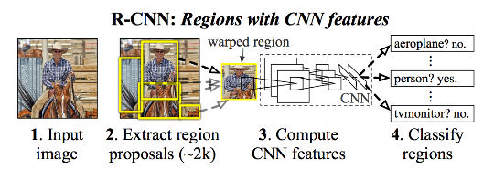
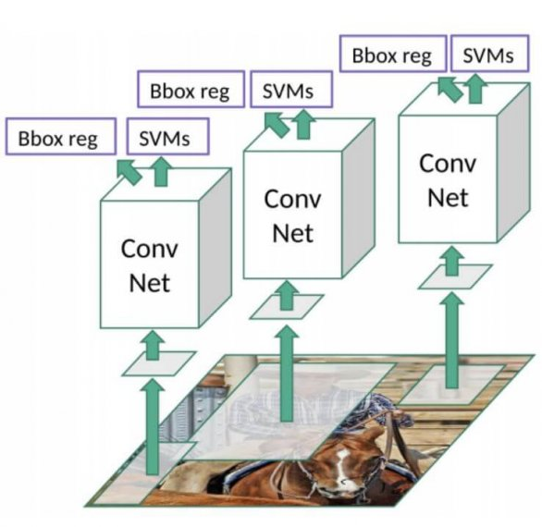
R-CNN (Region Based Convolutional Neural Network)
01
One of the first models proposed for object detection, which used convolutional neural networks.
RCNN consist of three modules
generating region proposals
linear Support Vector Machines for classification
regression algorithm for bounding box prediction
02
03
Region proposal are created using Selective Search Algorithm
Then they are warped to a standard size & passed through a CNN for feature extraction.
Then they are passed through a CNN for object classification
Then through a regressor that predicts co-ordinates & centroid of the bounding box for each object of interest.
This Convolutional neural network is knows as feature extractor and is a pre-trained model such as VGG-16, Resnet, Mobilenet, Inception-Resnet
04
Drawbacks
Training is a multi-stage pipeline
around 2000 proposals are made for each image requiring a lot of disc space as well as time

Slide 4
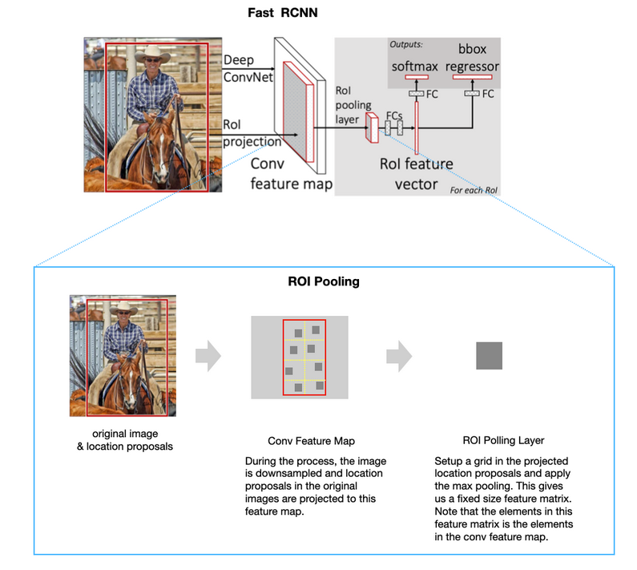
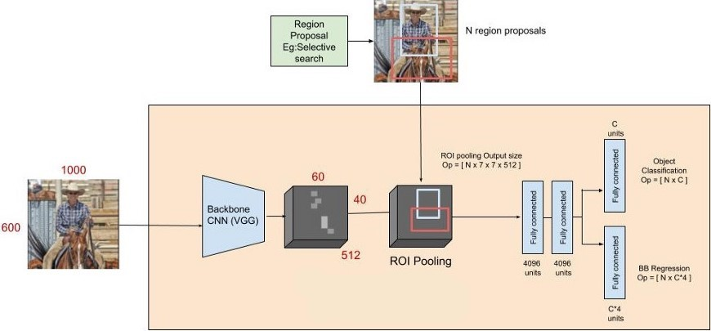
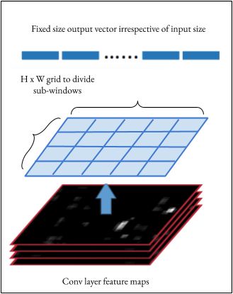
Fast R-CNN Algorithm
Similar to R-CNN, just that it expects region proposals to be fed in with images rather than proposing them itself.
01
02
We run the CNN only once per image sharing the computation among 2,000 region proposals.
The CNN processes the image and outputs a feature map
Input region proposals are used to extract the ROI from feature map & create a region proposal feature map for each proposed region called a the ROI Projection
Then down-sample this feature map with the help of a ROI pooling layer to get a fixed length feature map
The second insight of Fast RCNN is to jointly train the CNN, classifier, and bounding box regressor in a single model
03
Drawbacks
much faster as compared to R-CNN. But with large real-life datasets, it does not works so fast
04

Slide 5
Faster R-CNN Algorithm
Fastest of R-CNN family of Algorithms
Region proposals are created within the Algorithm.
01
02
Faster R-CNN Algorithm in 2 parts
first one was the deep fully convolutional network that proposed regions known as Region Proposal Network (RPN)
Second one was a Fast R-CNN detector that used proposed regions for object detection
03
A Region Proposal Network (RPN) takes an image as input & outputs object proposals, each with an object confidence score
The k proposals are parameterized relative to k reference boxes, which are called Anchors
Drawbacks
RPN is trained where all anchors are are extracted from a single image. As all samples may be correlated,it may take time to converge.
It is also a multi-stage object detection algorithm
04

Slide 6
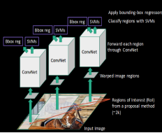
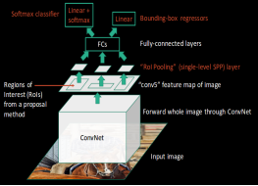
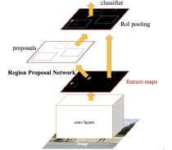
 | R-CNN | Fast R-CNN | FasterR-CNN
Architecture
Method For Generating Region Proposals | Selective Search | Selective Search (External) | Region Proposal Network
The mAP*on Pascal VOC 2007 test dataset (%) | 58.5 | 66.9 (trained with VOC 2007) 70.0 (trained with VOC 2007 & 2012) | 66.9 (trained with VOC 2007) 70.0 (trained with VOC 2007 & 2012)
The mAP* on Pascal VOC 2012 test dataset (%) | 53.3 | 65.7 (trained with VOC 2012) 68.4 (trained with VOC 2007 & 2012) | 67.0 (trained with VOC 2012) 70.4 (trained with VOC 2007 & 2012)
Detection Time (sec) | ~ 49 (with region proposal generation) | ~ 2.3 (with region proposal generation) | 0.2 (with VGG),0.059 (with ZF)

Slide 7
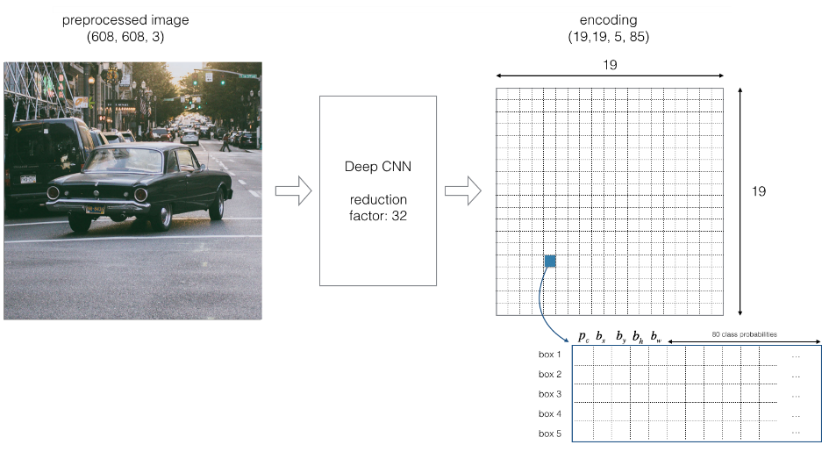
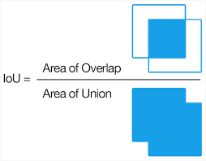
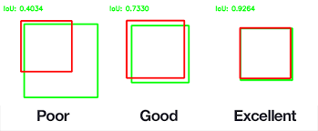
YOLO (You Only Look Once) Algorithm
01
In YOLO, Object detection as a single regression problem also known as single stage detector
bbox coordinates & class probabilities all are computed in just a single run of algorithm
02
YOLO sees the entire image during training & test time so it makes < 1/2 the no. of background errors compared to Fast R-CNN.
We split image into grid, where each grid cell is responsible for predicting ‘B’ bounding boxes & confidence scores of the object
03
Intersection Over Union (IOU) is a metric used to judge the accuracy of the bounding box predicted by the model.
Non-max Suppression reduces the no. of predicted b.boxes by taking the larges probability associated with each detection
Drawbacks
The major problem with YOLOv1 is its inability to detect very small objects.
04

Slide 8
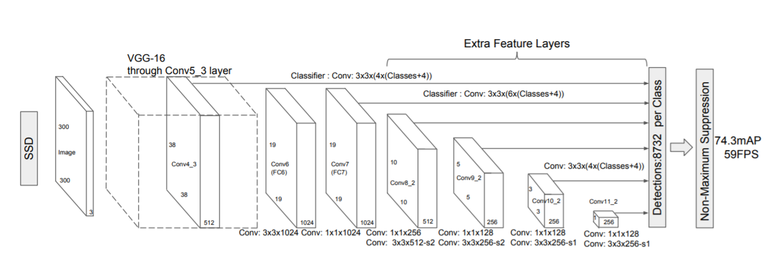
SSD (Single Shot Detector) Algorithm
01
SSD algorithm has two main components: a backbone model and a head
Backbone model is a pre-trained image classification network (CNN) known as a feature extractor
some convolutional feature layers are added to the end of the truncated base network known as Head
Thus we have deep neural network able to extract semantic meaning from the input image while preserving the spatial structure of the image at a lower resolution
02
03
SSD also divides the input image into a grid where each grid cell is responsible for detecting objects in that region of the image
Each grid cell in SSD can be assigned with multiple anchor/prior boxes icase there are multiple objects in one grid cell
Drawbacks
Shallow layers in a neural network may not generate enough high level features to do prediction for small objects
04

Slide 9
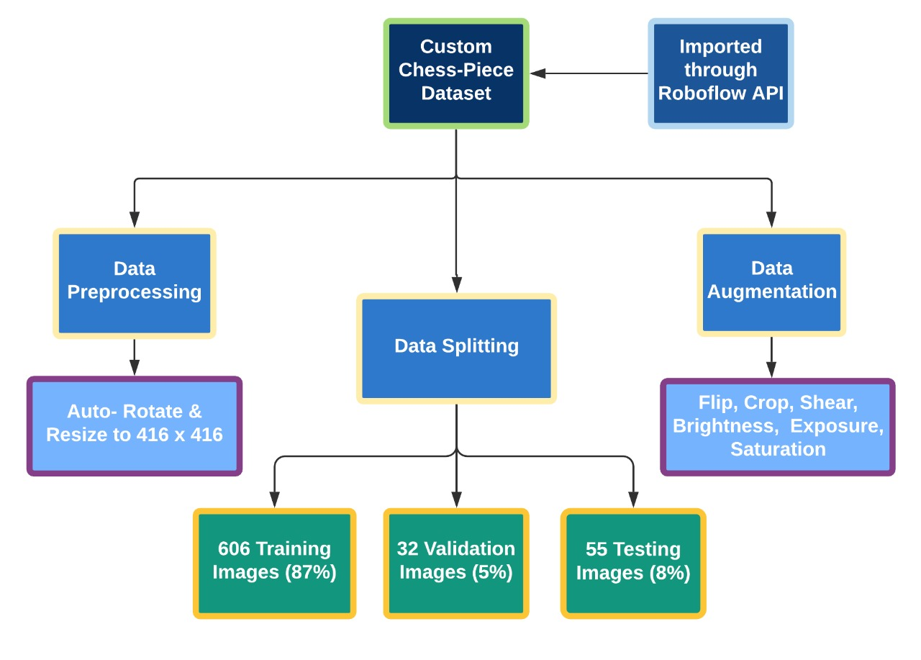
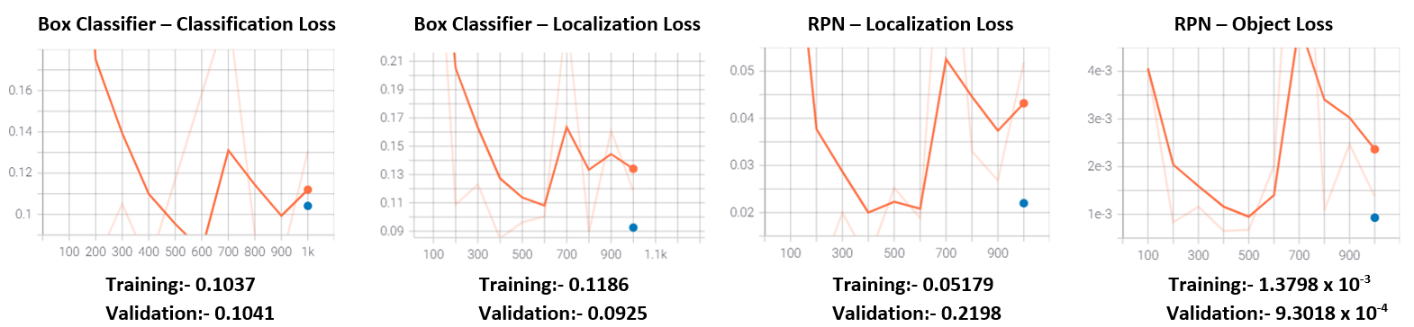
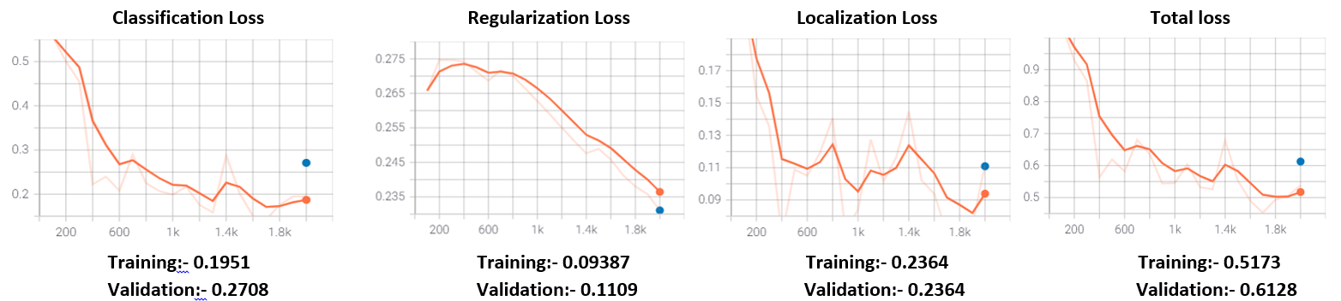
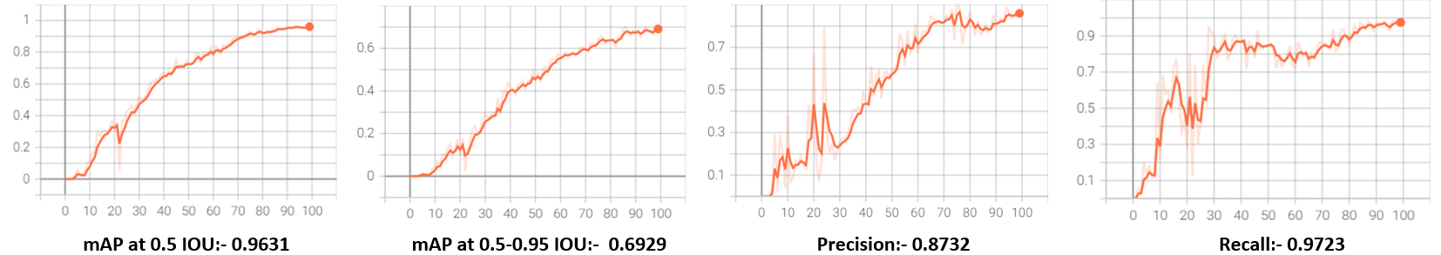
Dataset Description
Faster R-CNN Loss Metrics
SSD Loss Metrics
Yolo Metrics

Slide 10
Orignal Dataset :- https://public.roboflow.com/ds/2JhywcdZdh?key=lSjdOpj6jk
Google Colab. Notebooks:- Yolo v5:- https://colab.research.google.com/drive/1PpcD496Wovp6CFDXnn-LzmsyPxLyISG-?usp=sharing SSD:- https://colab.research.google.com/drive/1s9hDS75g1ObUSpHNC1wNOoWOt0qY66xv?usp=sharing Faster R-CNN:- https://colab.research.google.com/drive/1cS_Ghotzz5DcffkTCwsroBQhDn-hVRa2?usp=sharing
Orignal Dataset :- https://public.roboflow.com/ds/2JhywcdZdh?key=lSjdOpj6jk
Google Colab. Notebooks:- Yolo v5:- https://colab.research.google.com/drive/1PpcD496Wovp6CFDXnn-LzmsyPxLyISG-?usp=sharing SSD:- https://colab.research.google.com/drive/1s9hDS75g1ObUSpHNC1wNOoWOt0qY66xv?usp=sharing Faster R-CNN:- https://colab.research.google.com/drive/1cS_Ghotzz5DcffkTCwsroBQhDn-hVRa2?usp=sharing
 | Faster R-CNN | YOLO | SSD
Box Loss | Train :- 0.1186 (localization loss) Test:- NA | Train:- 0.028 Test:- 0.021 | Train:- 0.09 Test:- 0.11
Classification Loss | Train:-0.10 Test:- 0.11 | Train:- 0.015 Test:- Test: 9.17 x 10⁻³ | Train:- 0.19 Test:- 0.27
mAP @ 0.5 IOU | 0.99 | 0.96 | 0.95
AR (Average Recall) | 0.749 | 0.97 | 0.669
Object Loss | (RPN Object Loss)Train: 1.3 x 10⁻³ Test: 9.30 x 10⁻⁴ | Train: 0.04 Test: 0.02 | NA

Slide 11
References
Girshick, Ross, et al. "Rich feature hierarchies for accurate object detection and semantic segmentation." Proceedings of the IEEE conference on computer vision and pattern recognition. 2014.
Girshick, Ross. "Fast r-cnn." Proceedings of the IEEE international conference on computer vision. 2015.
Ren, Shaoqing, et al. "Faster r-cnn: Towards real-time object detection with region proposal networks." arXiv preprint arXiv:1506.01497 (2015)
Redmon, Joseph, et al. "You only look once: Unified, real-time object detection." Proceedings of the IEEE conference on computer vision and pattern recognition. 2016.
Liu, Wei, et al. "Ssd: Single shot multibox detector." European conference on computer vision. Springer, Cham, 2016.
https://medium.com/hackernoon/evolution-of-image-recognition-and-object-detection-from-apes-to-machines-580ed4247f1e
https://www.analyticsvidhya.com/blog/2018/10/a-step-by-step-introduction-to-the-basic-object-detection-algorithms-part-1/

Slide 12
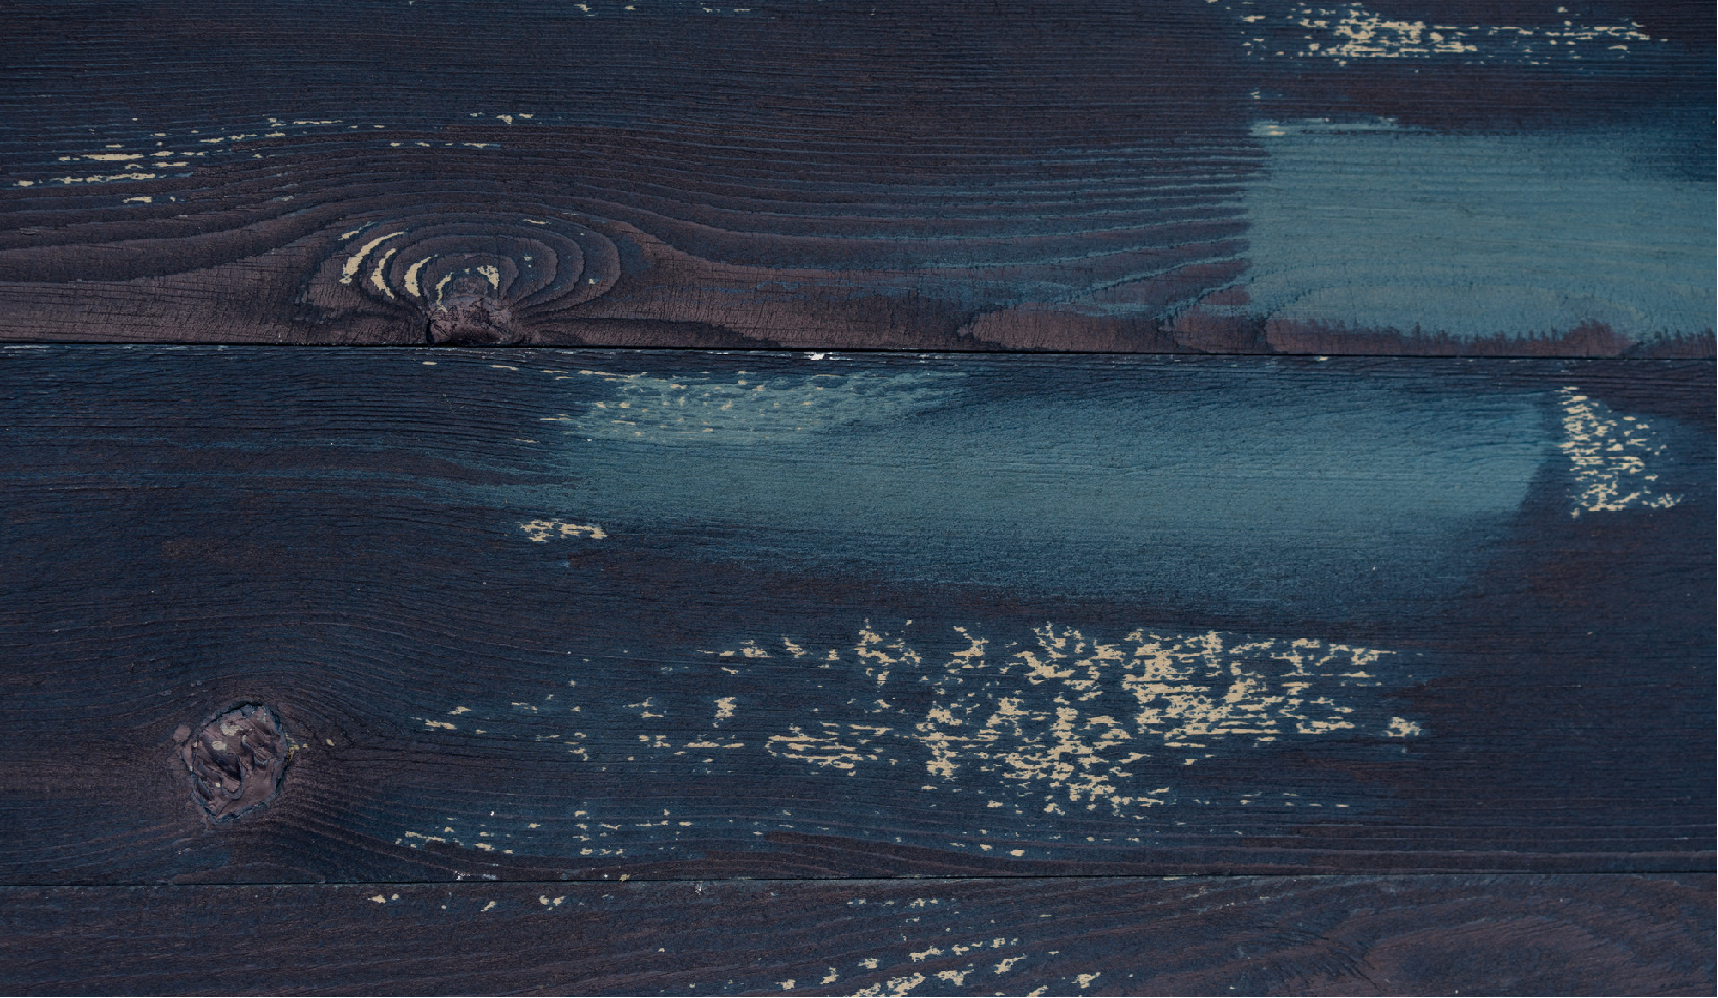
“
THANK YOU
- By Vibhu Gupta
5CSE-3Y
A2305219217
”

